Slide 1
Digital Portfolio
STUDENT NAME : M. Kayalvizhi
REGISTER NO. & NM ID : 24131241802522015 & 2E9A79CF03F6A43BC534A85EE97C2ED6
DEPARTMENT : B.SC-COMPUTER SCIENCE
COLLEGE : GOVERNMENT ARTS & SCIENCE COLLEGE, VADALORE.

Slide 2

STUDENT DIGITAL PORTFOLIO
This Presentation was Created using Microsoft Power Point

Slide 3
Agenda
Problem Statement
Project Overview
End Users
Tools and Technologies
Portfolio Design and Layout
Features and Functionality
Results and Screenshots
Conclusion

Slide 4
Project Overview
My project is to explain my web page of my Portfolio.
It clearly explains my Details, my Achievements and my Skills .

Slide 5
Who are the End Users ?
STUDENT
MY RESUME :
Name : M. Kayalvizhi
Age : 18
Father's Name : Murugan
Typewriting Skills : English-Junior
Knows Of Programming Language : Python, C++, Java, HTML, JS, SQL.
Projects : School/College Management
Additional Certificates : DMS
Contact Mail ID : mkayalvizhi610@gmail.com

Slide 6
Tools And Techniques
HTML – Tags and Body of my page
CSS – Styling and Cascading my Pages
JS – Interactions and Dynamically Works
Editor - Codepen

Slide 7
Features And Functionality
Navigation Bars
Interactive Elements
Smooth Scrolling

Slide 8
Portfolio Design And Layout
About Me
Achievements
Contact
Skills
Interactive
Working (Mobile)

Slide 9
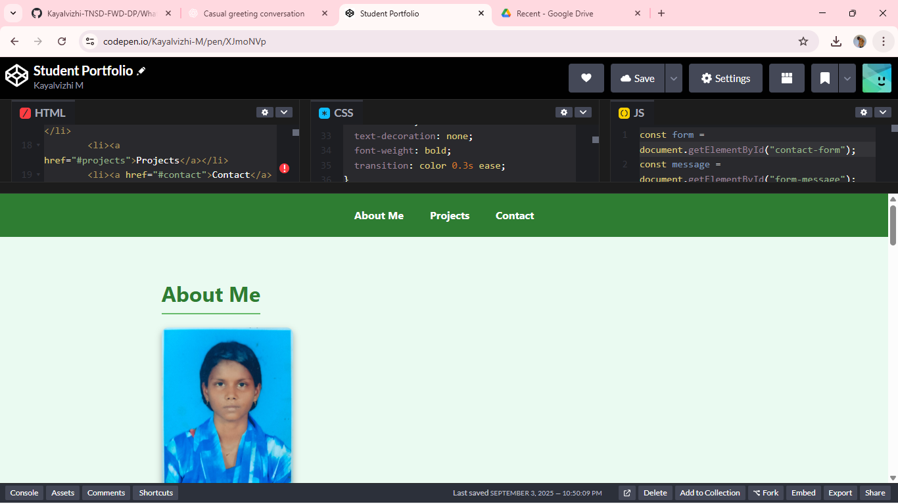
Results and Screen Shots

Slide 10
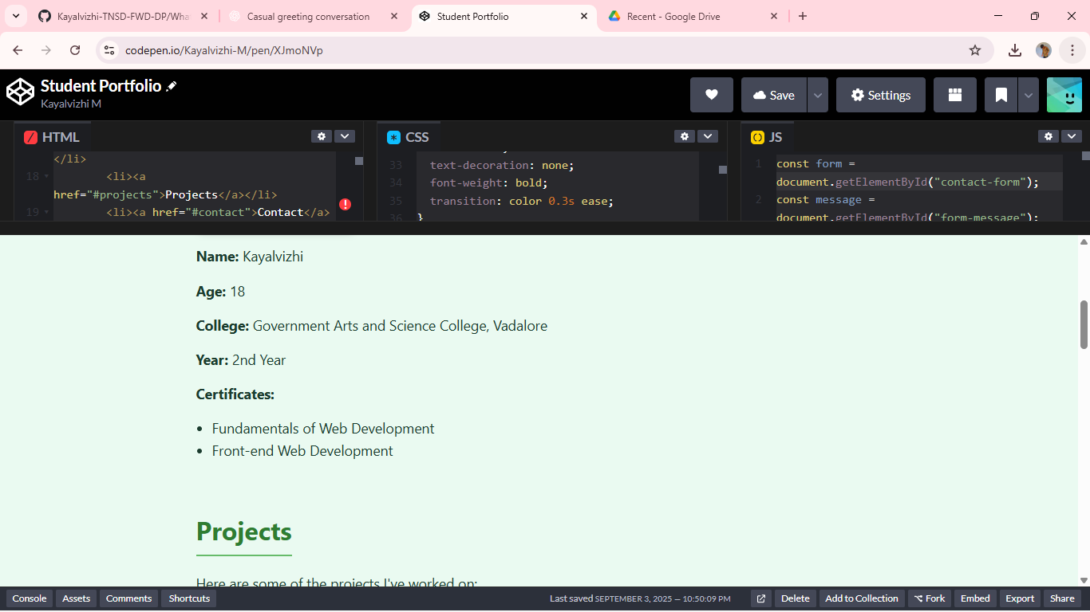
Results and Screen Shots

Slide 11
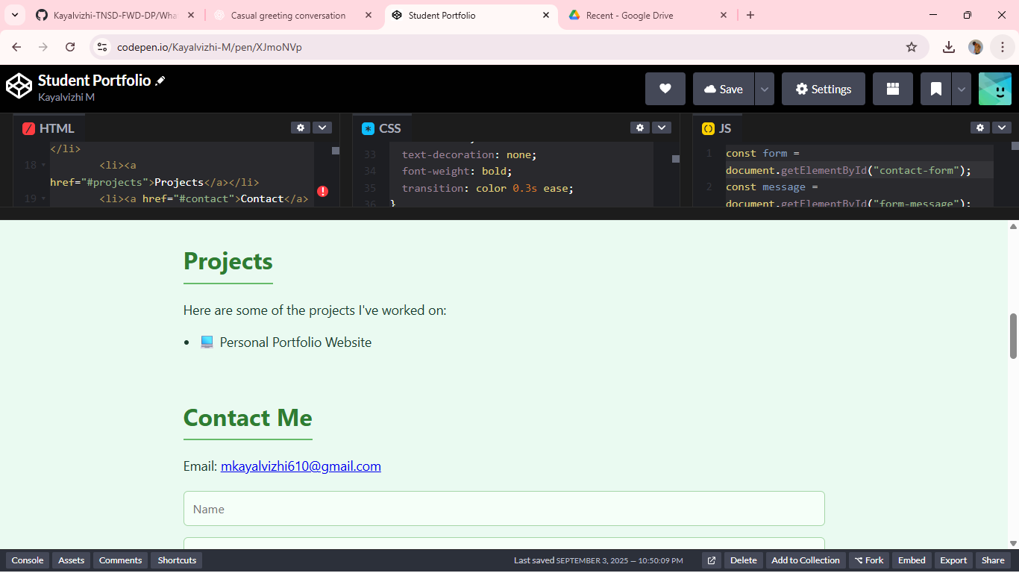
Results and Screen Shots

Slide 12
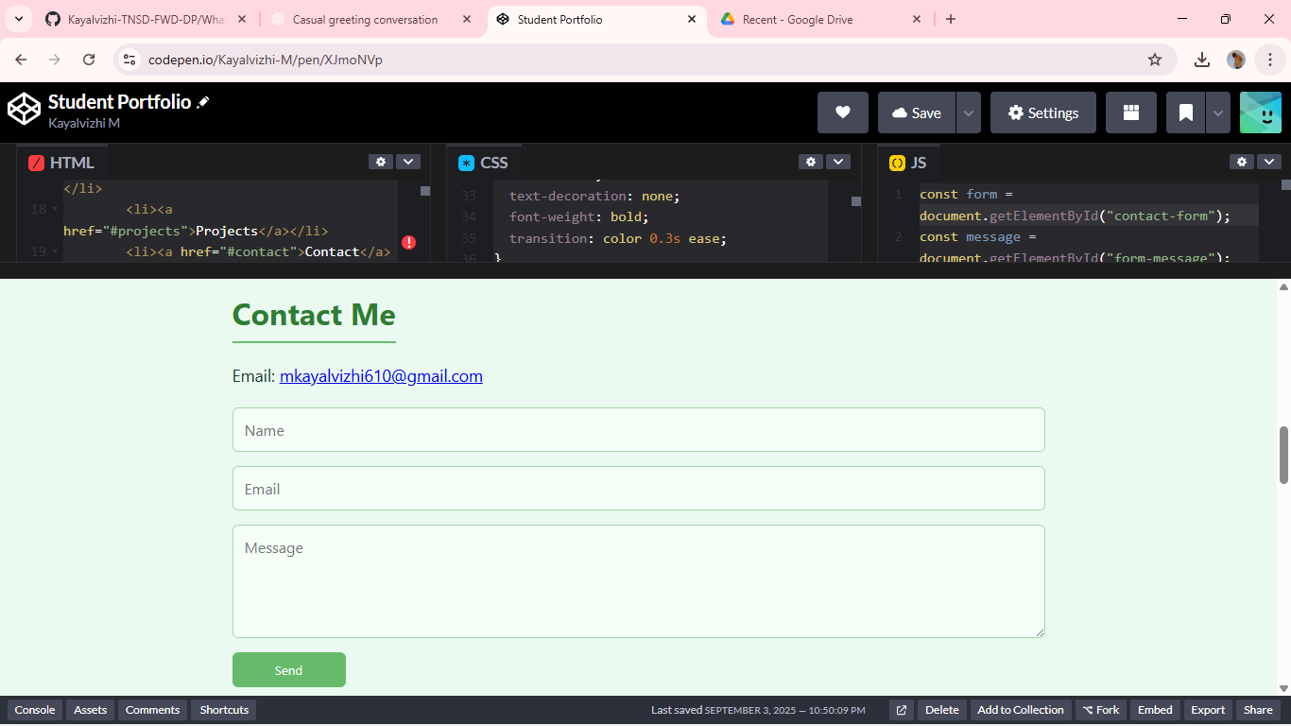
Results and Screen Shots

Slide 13
I Am Very Sincere To Work And Depth Of Programming Language. Thanking You... Yours Obediently, M. Kayalvizhi

Slide 14
Conclusion
I'm Very Excited To Create My Own PPT For Naan Mudhalvan.
Thank You For This Opportunity...

